Slide 1
Network Intrusion Detection
By :
Shahad Alomayrah

Slide 2
01
04
02
05
03
06
Overview
EDA
Dataset
Classification algorithms
Data Preprocessing
Confusion matrix

Slide 3
Overview
The issue Network intrusion detection is an important and sensitive issue when it comes to the privacy of organizations and individuals, especially when transmitting important and sensitive information

Slide 4
DataSet
Collected the data from Kaggle website
2938 Columns
22 Rows
.

Slide 5
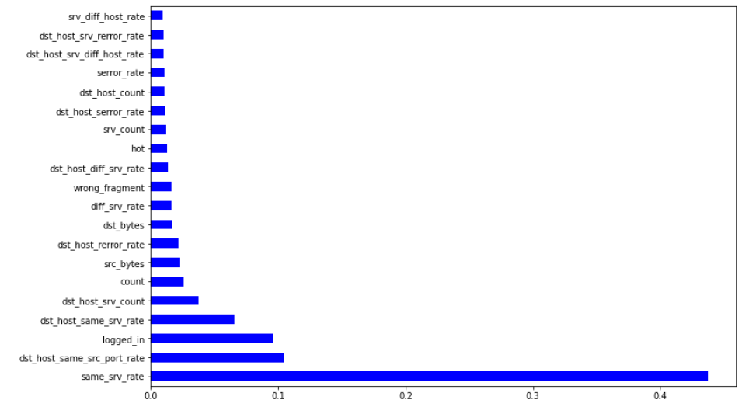
Feature Importance

Slide 6
Data Preprocessing
Feature Selection
check duplicat
Label Encoding
rename column
Scaler

Slide 7
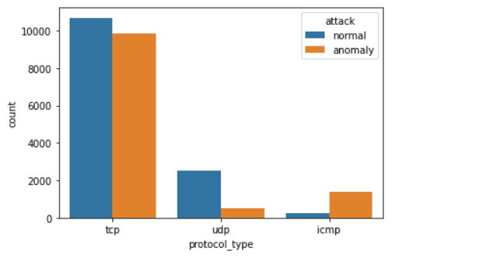
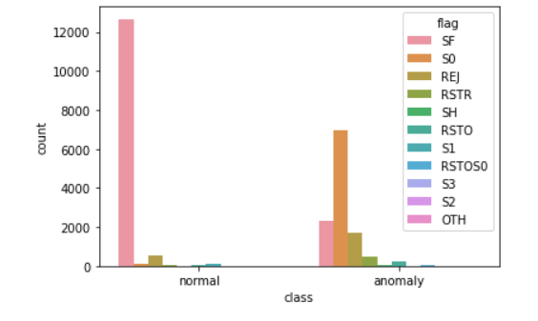
EDA
Protocol safer TCP and the most protocol that happens in it anomaly UDP
The safer is flag SE

Slide 8
Experiments - Results
LogisticRegression | 0.94 | 0.95 | 0.95 | 0.95 | 0.95 | 0.94
KNN | 0.65 | 0.66 | 0.66 | 0.60 | 0.48 | 0.80
Decision Trees | 0.96 | 0.96 | 0.96 | 0.96 | 0.97 | 0.96
Randomforest | 1 | 0.99 | 0.99 | 0.99 | 0.99 | 0.99
XGBoost | 1 | 0.99 | 0.99 | 0.99 | 0.99 | 0.99
Model
Training
Test
Accuracy
F1-Score
Recall
Precision

Slide 9
Experiments - Results
Model
Training
Test
Recall
Precision
graid Search RandomForest | 0.99 | 0.99 | 0.99 | 0.99
graid Search KNN | 0.98 | 0.97 | 0.97 | 0.97
graid Search LogisticRegression | 0.87 | 0.88 | 0.88 | 0.88

Slide 10
Experiments - Results
Bagging | 0.87 | 0.88
Hard Voting | 1 | 0.99
Model
Training
Test
Confusion matrix of Best Model

Slide 11
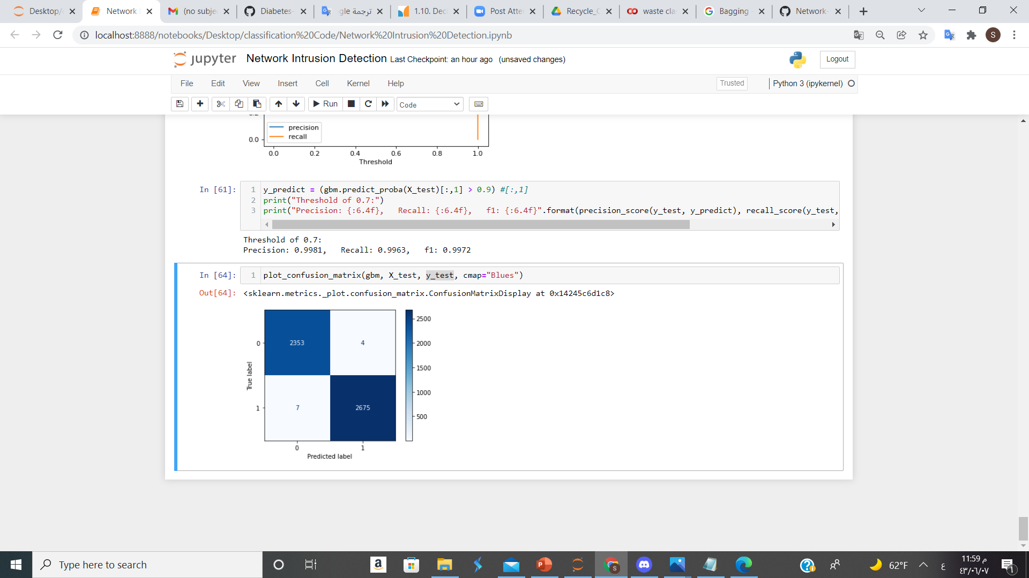
Confusion matrix of Best Model
XGBoost

Slide 12
THANKS!
Do you have any questions?

